Slide 1
GLOBAL TRAVEL DISTRIBUTION
COVID-19 IMPACT
From Travel Consul
June 2020

Slide 2
ABOUT TRAVEL CONSUL
Travel Consul is an international travel marketing alliance consisting of (18) advertising, media, public relations and marketing firms spread across six different continents – all specializing in travel.
With over 600 clients in the travel and tourism sector, our global team of more than 850 experts work seamlessly to implement global strategies with unique hands-on local market knowledge and industry relationships. From B2B to B2C, Travel Consul helps government and commercial organizations.
For more information, please visit: www.TravelConsul.com

Slide 3
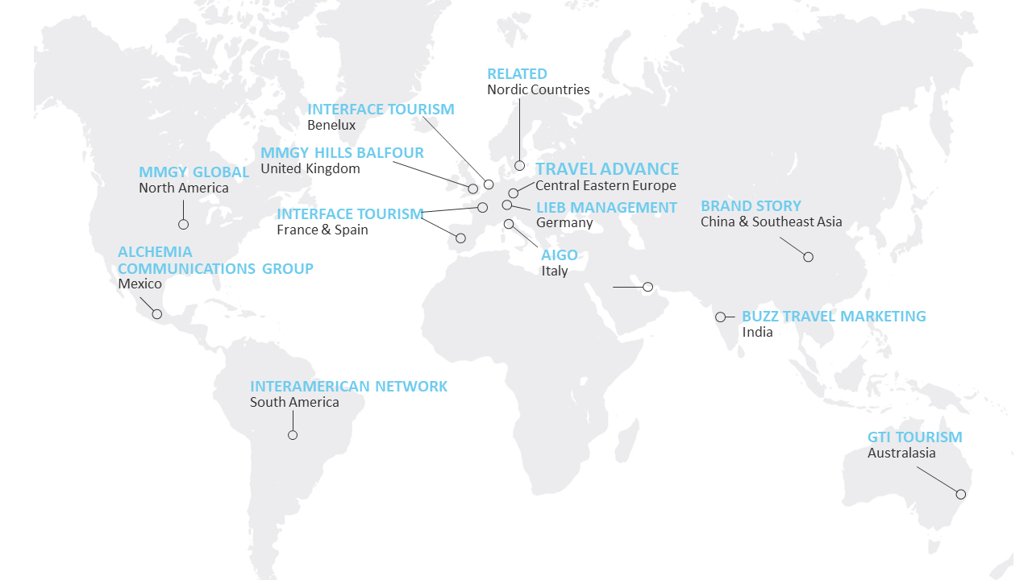
ABOUT THIS REPORT
Travel Consul, a global travel marketing alliance, conducted a global survey on the impact and outlook of the COVID-19 outbreak to travel distribution partners (tour operators and agencies owners).
Fourteen of Travel Consul’s partner agencies participated in this global research as shown on the map.
The survey was distributed from May 11 to May 25, 2020, in 8 languages: Chinese, Czech, English, French, Italian, Polish, Portuguese and Spanish.
The findings are based on 903 respondents from the main tourism source markets.
3

Slide 4
Respondents by Company Type and Region of Main Operation
GLOBAL TRAVEL DISTRIBUTION. COVID-19 IMPACT
903 COMPLETE GLOBAL RESPONSES
4

Slide 5
Globally, companies with less than ten employees represented 53% of the pre COVID-19 full time workforce
GLOBAL TRAVEL DISTRIBUTION. COVID-19 IMPACT
COMPLETE RESPONSES | GLOBAL: 903 | ASIA: 168 | AUSTRALIA: 24 | EUROPE: 393 | THE AMERICAS: 302
5

Slide 6
At a global level, 38% of the respondents reported moving from full-time to part-time. In North America employing independent contractors was the main option (28%) among the 167 partners taking the survey
GLOBAL TRAVEL DISTRIBUTION. COVID-19 IMPACT
“Other” include:
- On government furlough scheme
- Working from home
- Working less hours
- Paycuts up to 50%
- Combination: full time to part time and partly laid-off
6

Slide 7
Two-thirds of travel distribution partners anticipate being able to sustain their businesses for six months without government financial support
GLOBAL TRAVEL DISTRIBUTION. COVID-19 IMPACT
903 COMPLETE GLOBAL RESPONSES
Q13. Compared to the last calendar year (2019-2020), what % drop do you expect in business volume (revenues) for Q3 and Q4 2020?
73
Estimated decrease
in business volume in Q3 2020
%
60
Estimated decrease
in business volume in Q4 2020
%
7

Slide 8
New products design, training programmes and business model adaptation among the leading measures taken during the COVID-19 pandemic.
GLOBAL TRAVEL DISTRIBUTION. COVID-19 IMPACT
903 COMPLETE GLOBAL RESPONSES
8

Slide 9
Travel associations reported as primary data sources during the crisis
GLOBAL TRAVEL DISTRIBUTION. COVID-19 IMPACT
903 COMPLETE GLOBAL RESPONSES
9

Slide 10
Travel associations reported as primary data sources during the crisis
GLOBAL TRAVEL DISTRIBUTION. COVID-19 IMPACT
COMPLETE RESPONSES |ASIA: 168 | AUSTRALIA: 24 |EUROPE: 393 | NORTH AMERICA: 169 | SOUTH AMERICA: 82
10

Slide 11
Email is the leading communications formula during lockdown. Interestingly, the traditional use of the telephone was the second most utilized channel
GLOBAL TRAVEL DISTRIBUTION. COVID-19 IMPACT
903 COMPLETE GLOBAL RESPONSES
11

Slide 12
GLOBAL TRAVEL DISTRIBUTION. COVID-19 IMPACT
57
%
Expect to resume normal operations by 2021
34
%
Do not know
903 COMPLETE GLOBAL RESPONSES
Q15. When do you expect your business to go back to normal levels?

Slide 13
Clients are still waiting to decide where to travel next
GLOBAL TRAVEL DISTRIBUTION. COVID-19 IMPACT
903 COMPLETE GLOBAL RESPONSES
46
41
13
%
%
%
Are waiting to decide
Are looking to go to where they had originally booked
Are changing destination
Q10. With clients who are already showing some interest or rebooking, can you indicate the % for each of the following preferences?
13

Slide 14
GLOBAL TRAVEL DISTRIBUTION. COVID-19 IMPACT
TOP THREE REQUESTED ACTIONS FROM DMOS
Introducing health and safety certificates for agents to feel sure the destinations are safe to send their customers
Presenting useful and timely data
Marketing campaigns for consumers
Q12. How important are the following actions that destination organizations can do to help you once recovery commences?
903 COMPLETE GLOBAL RESPONSES
14
Notes:
ADD QUESTION

Slide 15
A further in depth look at the activities DMOs can do to support distribution partners in recovery
GLOBAL TRAVEL DISTRIBUTION SURVEY
903 COMPLETE GLOBAL RESPONSES
15

Slide 16
70% of the respondents believe that modifying cancellation policies or terms and conditions will be among their main undertakings in 2020
GLOBAL TRAVEL DISTRIBUTION. COVID-19 IMPACT
903 COMPLETE GLOBAL RESPONSES
16

Slide 17
Globally, almost half of the respondents are very likely to consider HOTELS & RESORTS not previously offered
GLOBAL TRAVEL DISTRIBUTION. COVID-19 IMPACT
903 COMPLETE GLOBAL RESPONSES
17

Slide 18
53% of distribution partners across the globe are very likely to contemplate DESTINATIONS not previously offered
GLOBAL TRAVEL DISTRIBUTION. COVID-19 IMPACT
903 COMPLETE GLOBAL RESPONSES
18

Slide 19
Globally, ca. 40% of respondents are very likely to consider SUPPLIERS they have never worked with before
GLOBAL TRAVEL DISTRIBUTION. COVID-19 IMPACT
903 COMPLETE GLOBAL RESPONSES
19

Slide 20
Two out of three respondents plan to focus on social media during recovery
GLOBAL TRAVEL DISTRIBUTION. COVID-19 IMPACT
903 COMPLETE GLOBAL RESPONSES
Other marketing activities include:
Newsletters
Virtual promotional events
Info sessions
Direct calls
In-person events
Networking
One-to-one meetings
Email outreach
Relaunching the website
Enhanced customer service
20

Slide 21
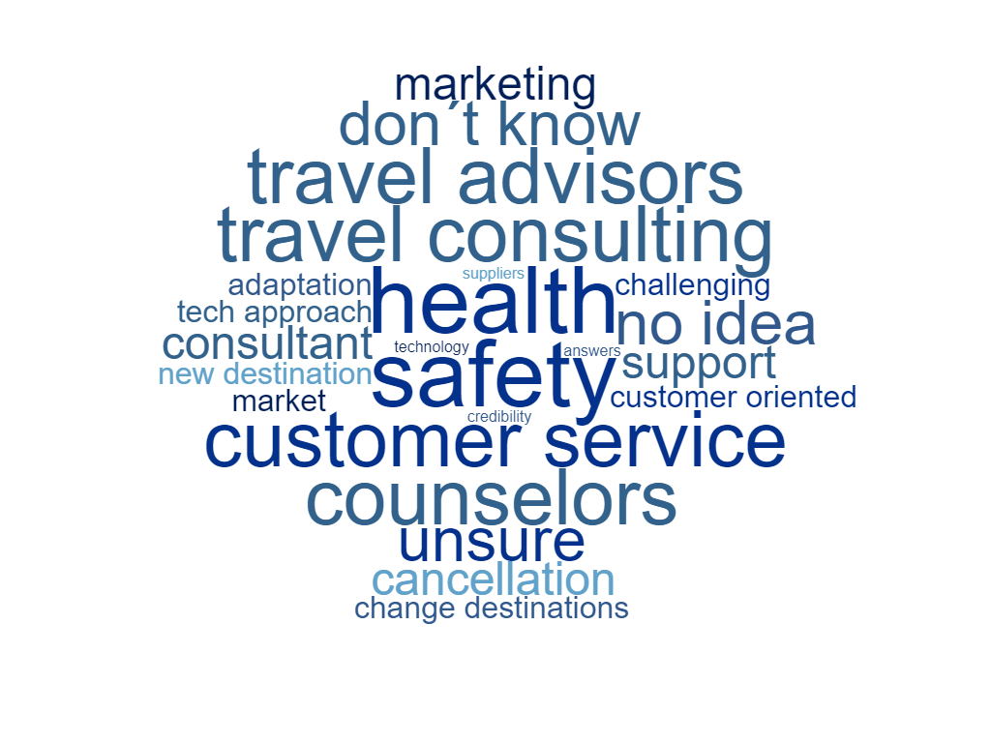
Changing roles
GLOBAL TRAVEL DISTRIBUTION. COVID-19 IMPACT
Q21. HOW DO YOU THINK YOUR ROLE WILL CHANGE GOING FORWARD INTO 2021 AND BEYOND?
ANSWERED: 657 SKIPPED: 246
“More customers will buy through operators for security and support issues”
“I believe customers will be more conducive to using a travel advisor than before”
“We will need to elude confidence in the safety of traveling”
“More travel consulting rather than product design”
“Customers will value the support of a travel consultant”
“New destinations and working with high-end clients”
“Adjustment on destination product based on market needs”
“Hard to predict”
“Unsure”
“We must have a more tech-approach to customer”
“Will be more detailed business service with accurate product”
“More on customer service, offer safety destination”
“More involved in tactical marketing to react to the recovery as it develops”
“Consolidate product and market knowledge”
21
Notes:
ADD THE QUESTION ON TOP
CREATE WORDCLOUD

Slide 22
THANK YOU
For more information, please contact:
XXXX
XXXX
Photo credit: Promote Iceland

